Slide 1
Semester Long Internship at Reliance Industries Limited
Mid Term Evaluation
Sujay Torvi (Roll number - 1821024)
Slide | 1

Slide 2
Introduction
Received Internship offer from RIL in November 2020
Internship at IT Division of Petchem Department of the company
Took opportunity of Semester Long Internship to get a headstart in my corporate career
Internship ended on May 7th 2021

Slide 3


Background of the industry
One of the biggest conglomerate companies in India.
Owned by well known businessman Mr. Mukesh Ambani
RIL has several businesses. Petchem is a part of a larger business of hydrocarbons.

Slide 4
Background of the industry
Petchem business has multiple products:
1. Polymer
2. Polyester
3. Elastonmers & many more
IT Division of Petchem Department provides automation systems for the department.

Slide 5
Motivation
Gives me a corporate experience before graduating:
1. Learn Agile workflow at an organization
2. Sharpen my development skills
An opportunity to be considered by the organization for full time offer
Add work experience in my Job Profile

Slide 6
Role – Full Stack Software Development Intern
Attend Project Scrum meetings and understand nature of the project and give any valuable suggestions
Finish tasks / deliverables assigned in the project which includes:
1. Identifying Fixing bugs of the system
2. Making CSS Changes wherever needed
3. Performing unit and negative testing and user acceptance testing
Providing support to other UA Testers from other development teams and guide them
4. Perform Documentation of the software

Slide 7
Internship Methodology
Orientation:
Setting up development environment
Understanding the project
Assignment of a learning project (for 1-1.5 months):
1. Learn technologies (Angular & Spring Boot) and apply it in the mini-project
2. Refer to YouTube videos, documentation to learn more
After sprint of the project starts, start contributing slowly to the project while learning simultaneously

Slide 8
Project Brief
Problem Statement:
Reliance Industries Limited collects and maintains a lot of data for its Petchem Business, this data is used for reports, audits and for analytics purposes
Data flows on a regular basis, this data has to be mapped in dashboards of visualization tools
Thus contents of data get frequently updated.
Ownership of data lies only with the business owner as per the organizational norms and rules. Due to dependency on IT Team it is an overhead
Requirement of the system that makes process automated, and removes the above said dependency, and optimizes overall process.

Slide 9
Project Brief
Users of the system:
User of use case: RIL Employee working in data / BI / Any other group of Petchem Department, who wishes to create a new use case and get it approved for his work.
L1 User: Immediate Reporting Managers of employee user
IT Admin: IT Head for particular division.
Business Data Owner: Head in charge for that particular business is the Business Data Owner.
Roles are specific to a use case. A person using the software may act as a use case user for one use case or an approver

Slide 10
Project Brief
Objectives:
Automate the process of approval of usecases by the business data owner
Allow an user to upload, download and search data while ensuring validity of the data and keeping logs of each and every activity
Generate log reports for audit

Slide 11
Project Brief
Workflow of the system:
User logs in to the system
Creates a new use case: User enters use case name and purpose of the use case. He then uploads an excel sheet, where the system picks the column names and displays on the screen. User now can choose which columns to be selected as unique key.
Use case goes for approval
Use case Submitted => L1 Approval => IT Admin Approval => Business Data Owner Approval
Once use case is approved, the use case is accessible to the appropriate users. User may now upload excel sheets, download data, delete and search the data based on column filters.
In the history tab, one may see successful uploads of data and those data that were rejected.

Slide 12
Project Brief
Software Requirements - Technology Stack:
Frontend Technology: Angular 9
Business Logic: JAVA SpringBoot
Database: MySQL
Hardware Requirements:
System deployed on kubernetes server. System is only accessible on RIL Intranet

Slide 13
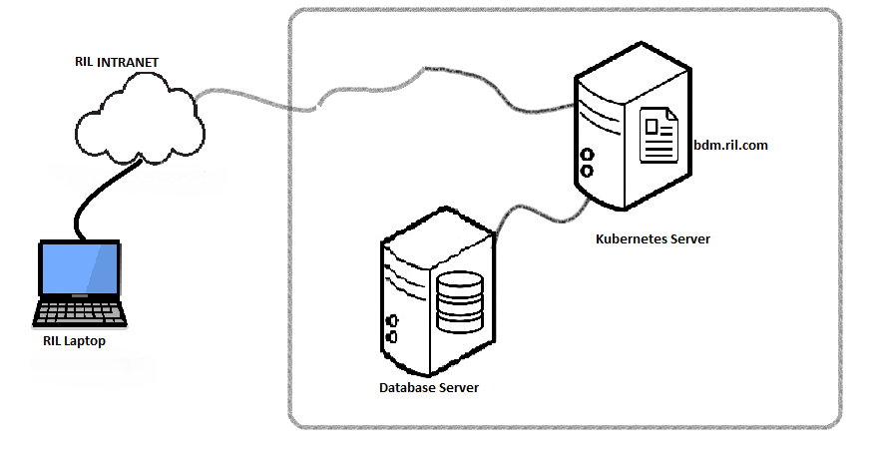
Project Brief
System Architecture

Slide 14
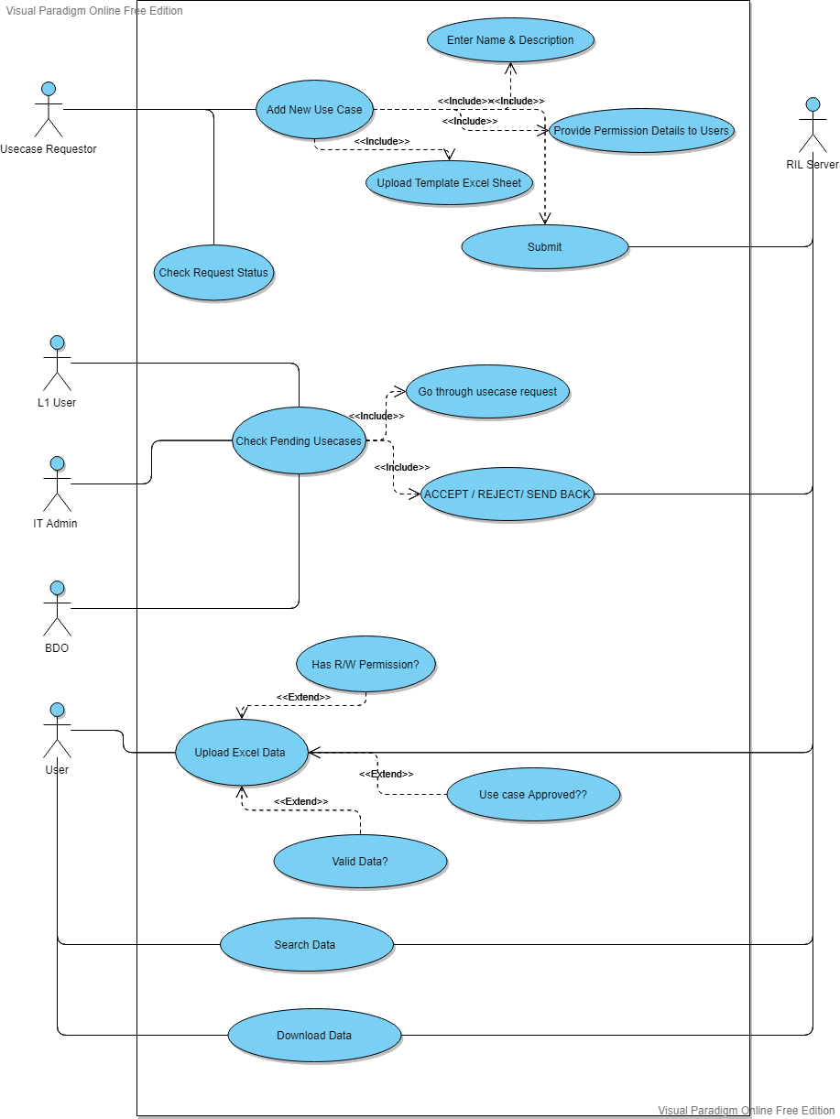
Project Brief
Use Case Diagram

Slide 15
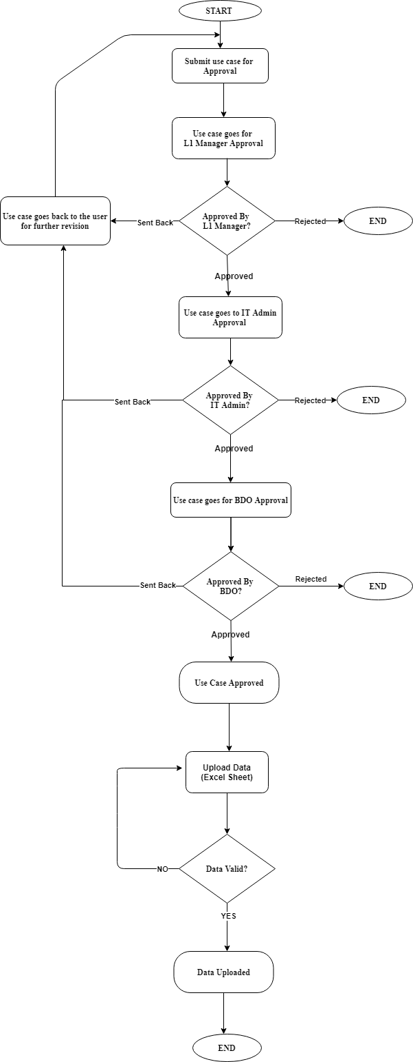
Project Brief
Approved Workflow Diagram

Slide 16
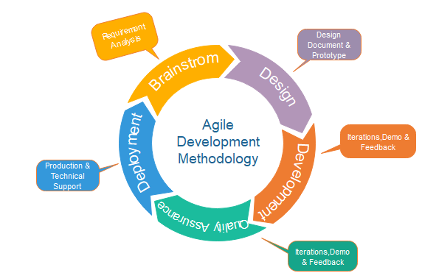
Software Development Lifecycle Model
Used in this project – Agile Scrum
Each Sprint lasts for 2 working weeks

Slide 17
Key Learnings from Internship
So far into the internship I have learnt:
Sharpened my rusty web development skills
- Applied angular concepts such as directives, routing, services, etc to a real life project
Learnt a new Java Framework: SpringBoot
- Learnt new concepts such as AOP, new java annotations
Learnt how to write clean code

Slide 18
Key Learnings from Internship
So far into the internship I have learnt:
• Testing: Gave me first-hand experience on the following types of testing – Validation Testing,
Negative testing and most importantly User Acceptance Testing.
• Documentation: Learnt how to create documentation for the system, such as creating Standard
Operating Procedure Manual for the system.

Slide 19
Soft Skills Learned
Enlisted below are the key soft skills I learned in the past months at RIL -
Collaboration Skills
Communication Skills
Work Ethics
Slide | 18

Slide 20
Significance of Courses taken during Engineering Program
The following courses, have played a signiﬁcant role in my transition to a Decision Analytics Associate Intern –
Web Technology – Semester 5
Open Source Lab – Semester 6
Object Oriented Programming & Methodology – Semester 3
Relational Database Management Systems – Semester 4
Software Engineering – Semester 5
Slide | 19

Slide 21
Conclusions
A corporate internship helps a lot before going as a full time employee, as one gets to see how a business problem is solved in the industry
Thus semester long internship opportunity adds a real value to the engineering course by giving industry experience thereby making student ready for employment and add greatly to my career experience
I would like to thank the KJSCE Committee for coming up with the Semester Long Internship scheme as well as RIL Stakeholders for offering me the internship opportunity and giving me the opportunity to enter the industry before I graduate.

Slide 22
References
Following are the references used:
https://en.wikipedia.org/wiki/Reliance_Industries
https://www.ril.com/
https://www.javatpoint.com/software-engineering-agile-model

Slide 23
Thank You

